Slide 1
Training Approaches and End-User Engagement
SPoRT Science Advisory Committee meeting, 26 July 2016

Slide 2
User Engagement
There is a constant process of growing and maintaining relationships with users/collaborators. (Weed’n Feed the ‘user garden’)
This takes time and effort (i.e. staff resources) that is not easily quantified but is important for long term success.
Activities for a healthy garden include:
Advocates (i.e. plant seeds)
Site visits (i.e. Weed’n Feed)
Coordination Calls (i.e. Weed’n Feed)
Intensive Product Evaluations (i.e. Watch’m grow)
User Feedback (i.e. harvest)
Transition to “normal” operations (i.e. keep growing what works)

Slide 3
User Engagement: Advocates
2 or more advocates per office
usually SOO and forecaster with the forecaster being the more active
“Spark to a flame” strategy: Invest in a small group at WFO who then spread the knowledge/skill to their peers.
Advocates have credibility and trust with their peers. Therefore, it’s key to have engagement at forecaster level, not just management level.
Advocate examples
Scotty Berg: Regularly uses products during shift-change briefings.
Paul Nutter: Promotes product applications via local blog; co-author of JOM publication
Brian Guyer, Edward Liske, Kris White: Demonstrate products to others while on shift
Mike Lawson: Contributes to Applications Library examples as resource for users
Etc.
P. Nutter
M. Stavish
D. Zaff
J. Hinsberger
R. Mazur
K. Angle
T. Turnage
M. Nordquist
L. Criderman
J. Hovis
L. Rosa
R. Walbrun
B. Guyer
A. Lese
J. Blaes
K. White
D. Schneider
M. Cantin
P. Camp
W. Collins
J. Medlin
D. Sharp
L. Wood
P. Santos
S. Berg
E. Rodriguez
M. Lawson
E. Liske
D. Wesley

Slide 4
User Engagement: Site visits
Walk a mile in their shoes to understand the issues and possible solutions.
Allows Q&A while at workstation with product and other data
Relationships are key
Understand user priorities, level of knowledge, product needs, data resources, time limitations
Invest time with individuals,
Example:
Visited Tuscon WFO while at AMS meeting. Provided training on products and noted their use of Blended TPW for precip issues.
Coordinated to transition LPW product which had already been evaluated by WFOs and they now mention it in AFDs frequently.
A publication by SPoRT and CIRA on LPW is in NWA JOM with cases from SJU, EKA, and AJK

Slide 5
User Engagement: Coordination Calls
How often?
3x/year
With what groups (WFOs & RFCs)?
East CONUS (April 2016)
West CONUS (March 2016)
National Centers (w/ Liaisons as needed)
Alaska (May 2016)
Pacific (via G. Stano w PRHQ as needed)
Goal of calls
Stay in touch with user needs and possible opportunities
Provide users with update on SPoRT activities and plans
Allow users to share experiences and/or issues with transition or application of product
Specific product training and/or assessment.
Agenda Example from May 2016 Alaska call
First half:
Quick review of select actions and associated issues
RGB Imagery: Ash-Pavlof,
Training and technical AWIPS issues
User Applications and/or Needs (input from WFOs, RFC, AAWU, CWSU)
Ongoing/Future: NUCAPS gridded data, ICESat-2, etc.
Second half:
Daytime Microphysics RGB and Summer Assessment (NOAA/JPSS)
NASA GPM-level 2 / -level 3 rain rates and upcoming assessment

Slide 6
User Engagement: Intensive Product Evaluations
Short testbed period with select users for “Trial” evaluation vs multiple users for an “Assessment”.
Transition occurs community wide when users feel there’s high value
Important to transition to “testbed” operations to determine “warts” that research validation may have missed in case studies.
Product and/or Training may need refinement based on results of user feedback.
SPoRT Assessments (Since ~2013):
QPE/LPW for atmospheric river and convection (Spring & Summer 2013)
VIIRS Day-Night Band and other Nighttime Imagery Impacts (Summer 2013)
NtMicro RGB to differentiate fog from low cloud (Fall/Winter 2013/14)
NASA/LIS Soil Moisture for Drought/Flood (Fall 2014)
NESDIS Snow Fall Rate (Winter 2014)
NtMicro vs 24-hr Micro RGB for Aviation (Winter 2014/15)
Disaster Assessment Toolkit (Spring 2015)
Total Lightning (pGLM) for Severe Weather (Spring 2015)
GOES-R CI for Aviation at CWSUs and WFOs (Summer 2015)
Total Lightning for Aviation Safety (Summer 2015)
24-hr Micro. RGB for Aviation (Summer 2015)
NASA/LIS soil moisture, NASA/GPM Rain Rate (Summer/Fall 2015)
NESDIS Snow Fall Rate (Winter 2015)
AVHRR NtMicro RGB impacts to Aviation in Alaska (Winter 2015/16)
JPSS/VIIRS Daytime Micro. RGB impacts to Aviation in Alaska (Summer 2016)

Slide 7
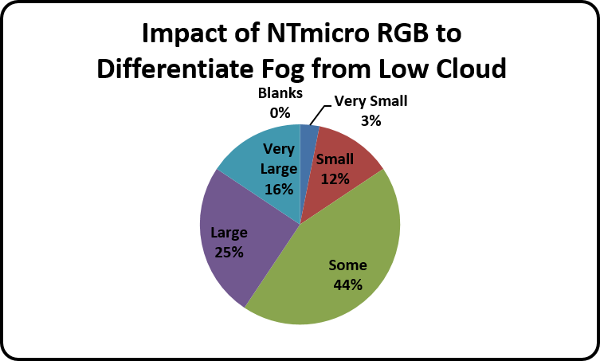
User Engagement: User Feedback
Online Feedback Form (partial) for Intensive Evaluations
Feedback obtained in many ways
Site visits, coordination calls, individual calls, Blog posts (Wide World of SPoRT or otherwise)
E-mail discussions with local Advocates
For intensive evaluations: Use of Google Form (see right as partial example)
“2-minute feedback form” Multiple choice / radio button questions to make it quick and easy
Can derive quantitative results
Optional “Comments” box for additional detail as needed.
Follow-up discussions to user feedback is very important to provide large impact/results (see next slide end-to-end example)

Slide 8
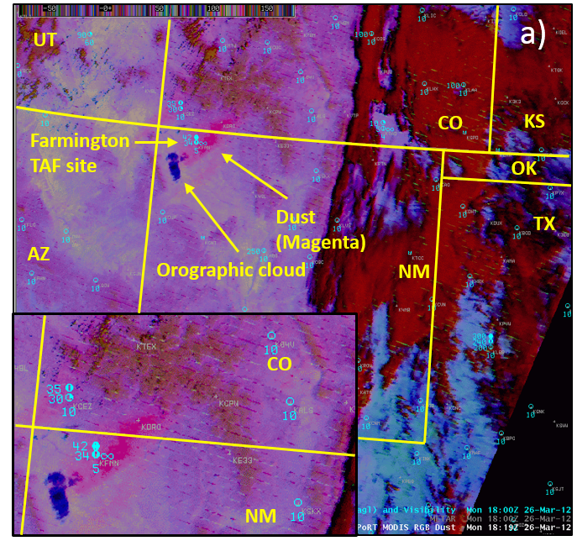
User Engagement: User Feedback
End-to-end Dust RGB transition w/ ABQ
2011 Transition of multispectral imagery for MODIS. (VIIRS to follow in 2012)
Problem:
Dust plumes blend with surface and cloud features in single channel and True Color imagery.
Dust hard to monitor at night.
Vast areas warned; few areas affected.
Solution/Evaluation: Dust RGB via MODIS & VIIRS in 2012-2014 with 18 cases documented by ABQ
Dust RGB allows operational change to begin issuing Blowing Dust Advisories and Dust Storm Warnings in 2014
Bryan Guyer of ABQ visits SPoRT in 2014 to present impact and describe limitations
SPoRT addresses bias issues between satellites
ABQ application of Dust RGB in operations is published in NWA JOM and peer-reviewed cases are used to create training in the form of 8 minute micro-lessons for eventual use in AWIPS Integrated Training Tool capabilities.
1819 UTC Dust RGB & Aviation Obs.
Figure 4 from Fuell et. al. 2016

Slide 9
User Engagement: User Feedback via demonstrations
SPoRT support of OPG Demo. of H8/AHI multispectral imagery.
Feedback: “The workshop was excellent! I also took away a deeper understanding of how our collaborations over the years have paved the way for GOES-R. Looping the RGB products was mind blowing.”
SPoRT support of HWT Demo. of proxy GLM total lightning product

Slide 10
User Engagement: Transition to “Normal” Operations
Proof of value: Users adopting products/method into “normal” operations
RGB Snow-Cloud with TFX Hydrologist (AMS Annual Meeting 2009) (see red boxes on right)
Blended TPW started at SPoRT and transitioned to NESDIS (paper, 2010)
Total Lightning at HUN, AWC (papers, 2010, 2015)
Airmass RGB at National Centers (paper, 2013)
GOES-R Convective Initiation at FCC/CWSU in large Situation Awareness monitor displays (site visits, custom domains)
NtMicro/24-hr Micro RGBs in AK (assessment report, regular AFD mentions, 2015)
Dust RGB in ABQ (paper, 2016)
Impact of Snow-Cloud RGB Imagery at TFX Related to Hydrologic Events (see text in red boxes)
Poster graphic created by Gina Loss (TFX) for AMS Annual Meeting 2009

Slide 11
User Engagement: Blog & Social Media
SPoRT has used its Wide World of SPoRT Blog to showcase and demonstrate applications since 2009.
Blog is used for peer to peer sharing, but only approved authors can create posts that outline their use of the product or application
SPoRT has expanded its presence on social media platforms (Twitter & Facebook) in order reach out to current and potentially identify end-users
Unknown WFOs using our products
Media members wanting to share images
Private sector users using our products and engaging to ask questions or submit comments

Slide 12
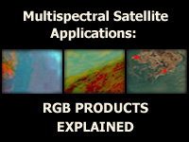
Training
Training that can be used or referenced quickly (sometimes while on shift)
Application oriented
Foundational materials incorporated via collaborations (i.e. COMET, etc.)
Training is a collaboration with users
Total Lightning (MLB, ZDV, MRX, etc.)
RGBs (Alaska, WR, SR WFOs)
NASA LIS (HUN)
SPoRT creates training and looks to assess the effectiveness of the training through the product evaluation phase.

Slide 13
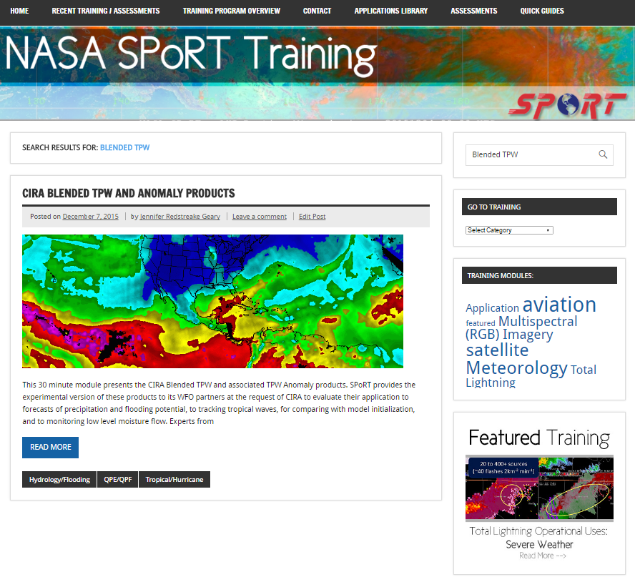
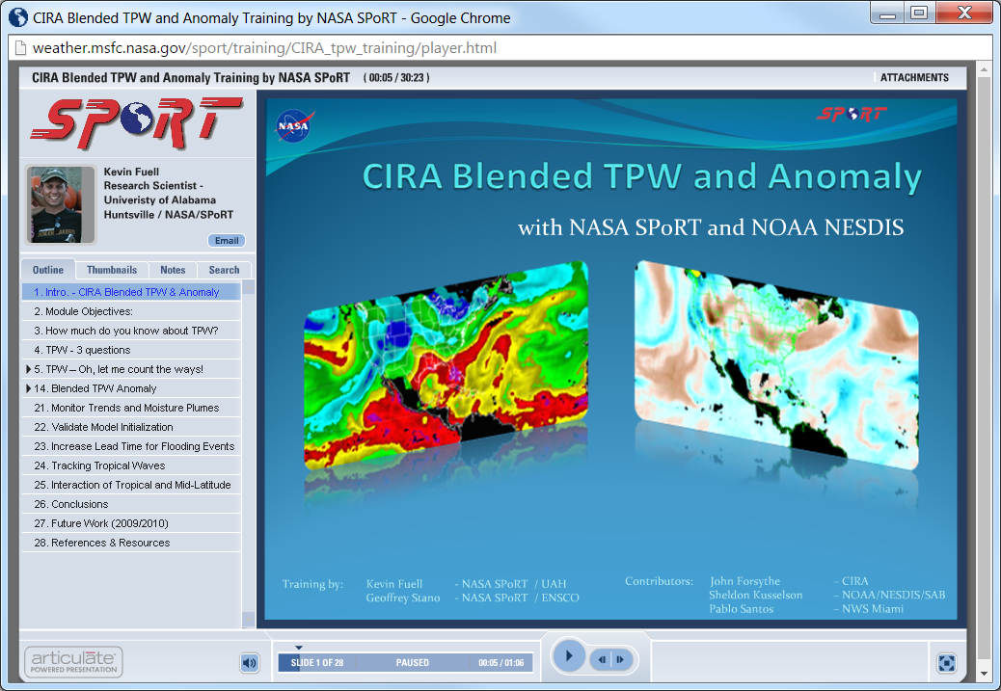
Training: Teletraining (with SME)
Reach advocates who filter information to staff
Q&A for users w/ developers
Multiple opportunities provided prior to product assessment (sometimes 1-on-1 with WFO or advocate)
Examples of SME Participation:
Dr. Bob Kuligowski: GOES-R QPE
Dr. Stan Kidder: Blended TPW
Dr. Huan Meng: Snow Fall Rate
Dr. Geoffrey Stano: pGLM Lightning
Dr. Gary Jedlovec: MODIS/VIIRS Imagery
Dr. George Huffman: IMERG Rain Rate

Slide 14
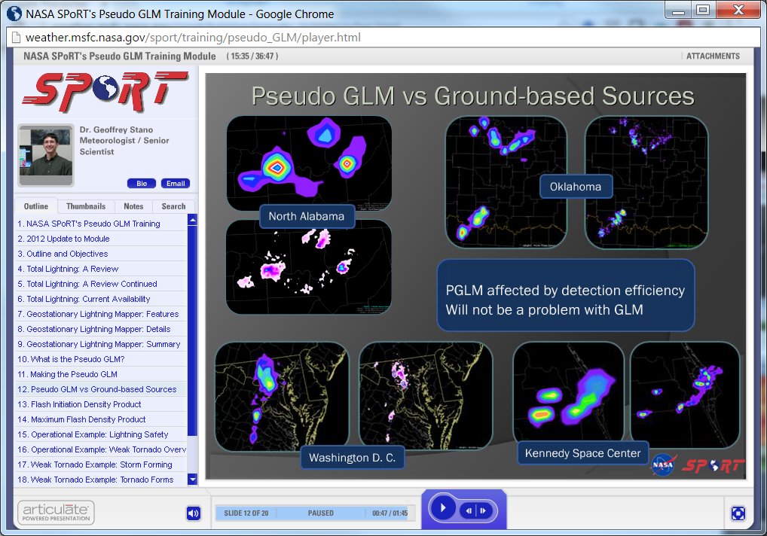
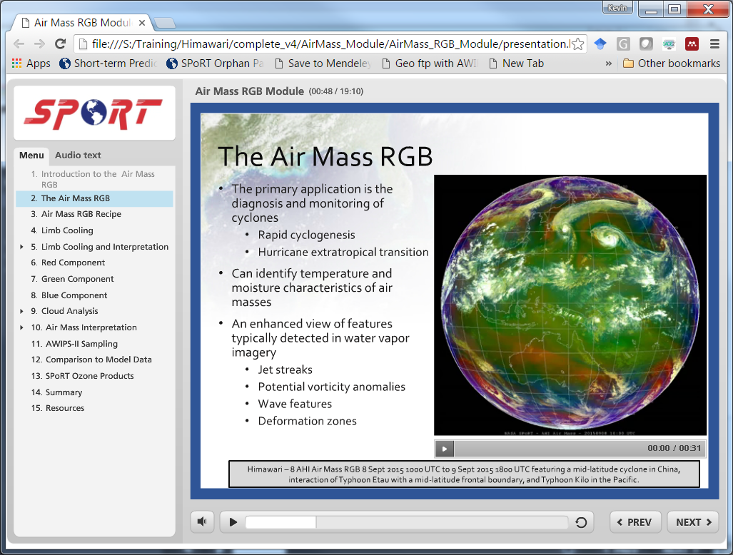
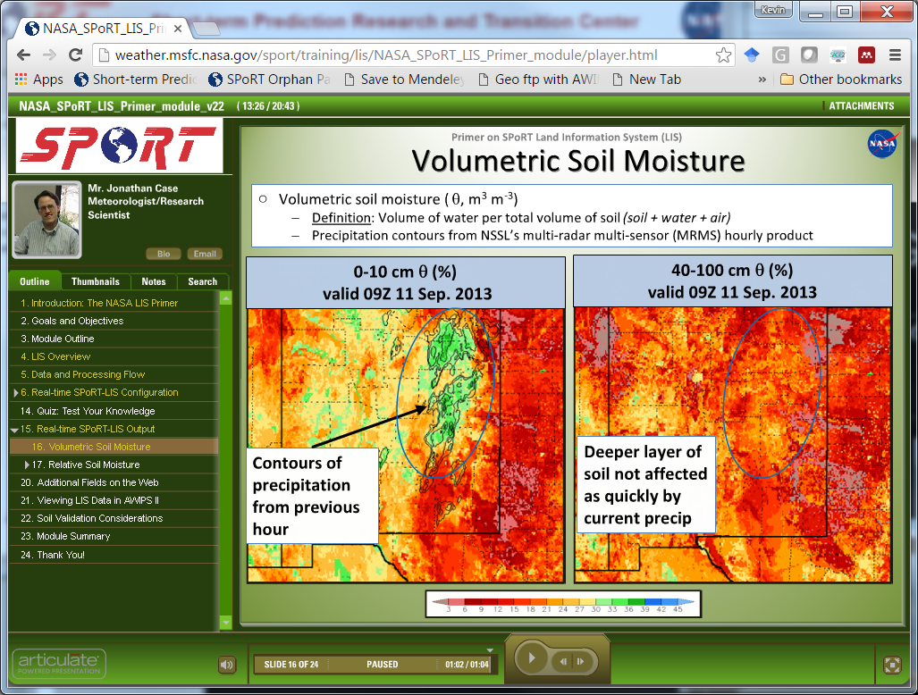
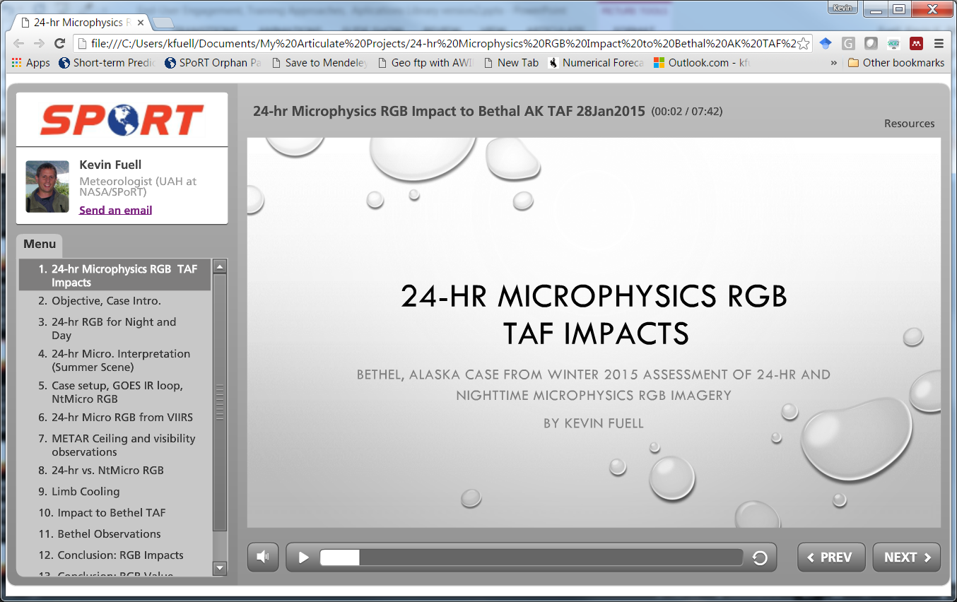
Training: Modules
Short contact time for use or reference during operations.
Application-based (foundational as needed)
Total Lightning training lacking in NWS until SPoRT transitions
PR interest: Existing Airmass RGB and NtMicro RGB modules, both using AHI, created for OPG Demo.
Utilize materials from other collaborators as pre-requisite
Have 7 modules in NOAA LMS

Slide 15
Training: micro-lesson
8 minutes or less in length
Very focused on application aspect
Could be done on a “quiet” shift
Easily referenced later
Builds upon user’s base training from other materials (COMET, VISIT, etc.) which tend to be an hour or more.
Application examples from user feedback / assessment
Leverage peer to peer method
Analogous to “Storm of the Month” presentations led by forecasters

Slide 16
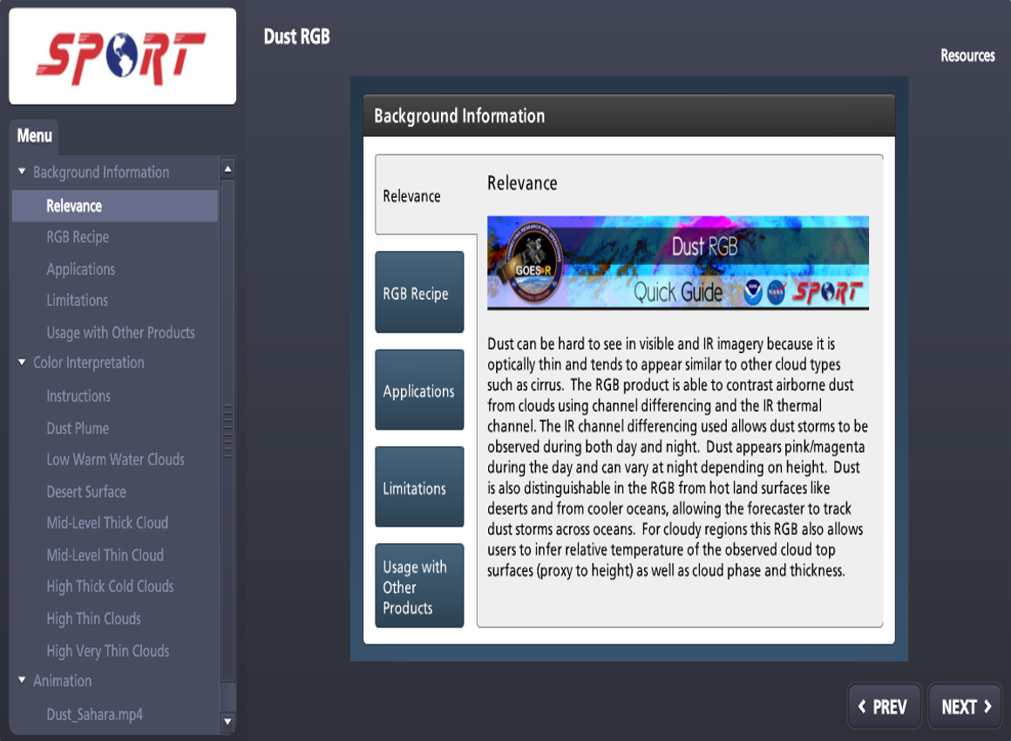
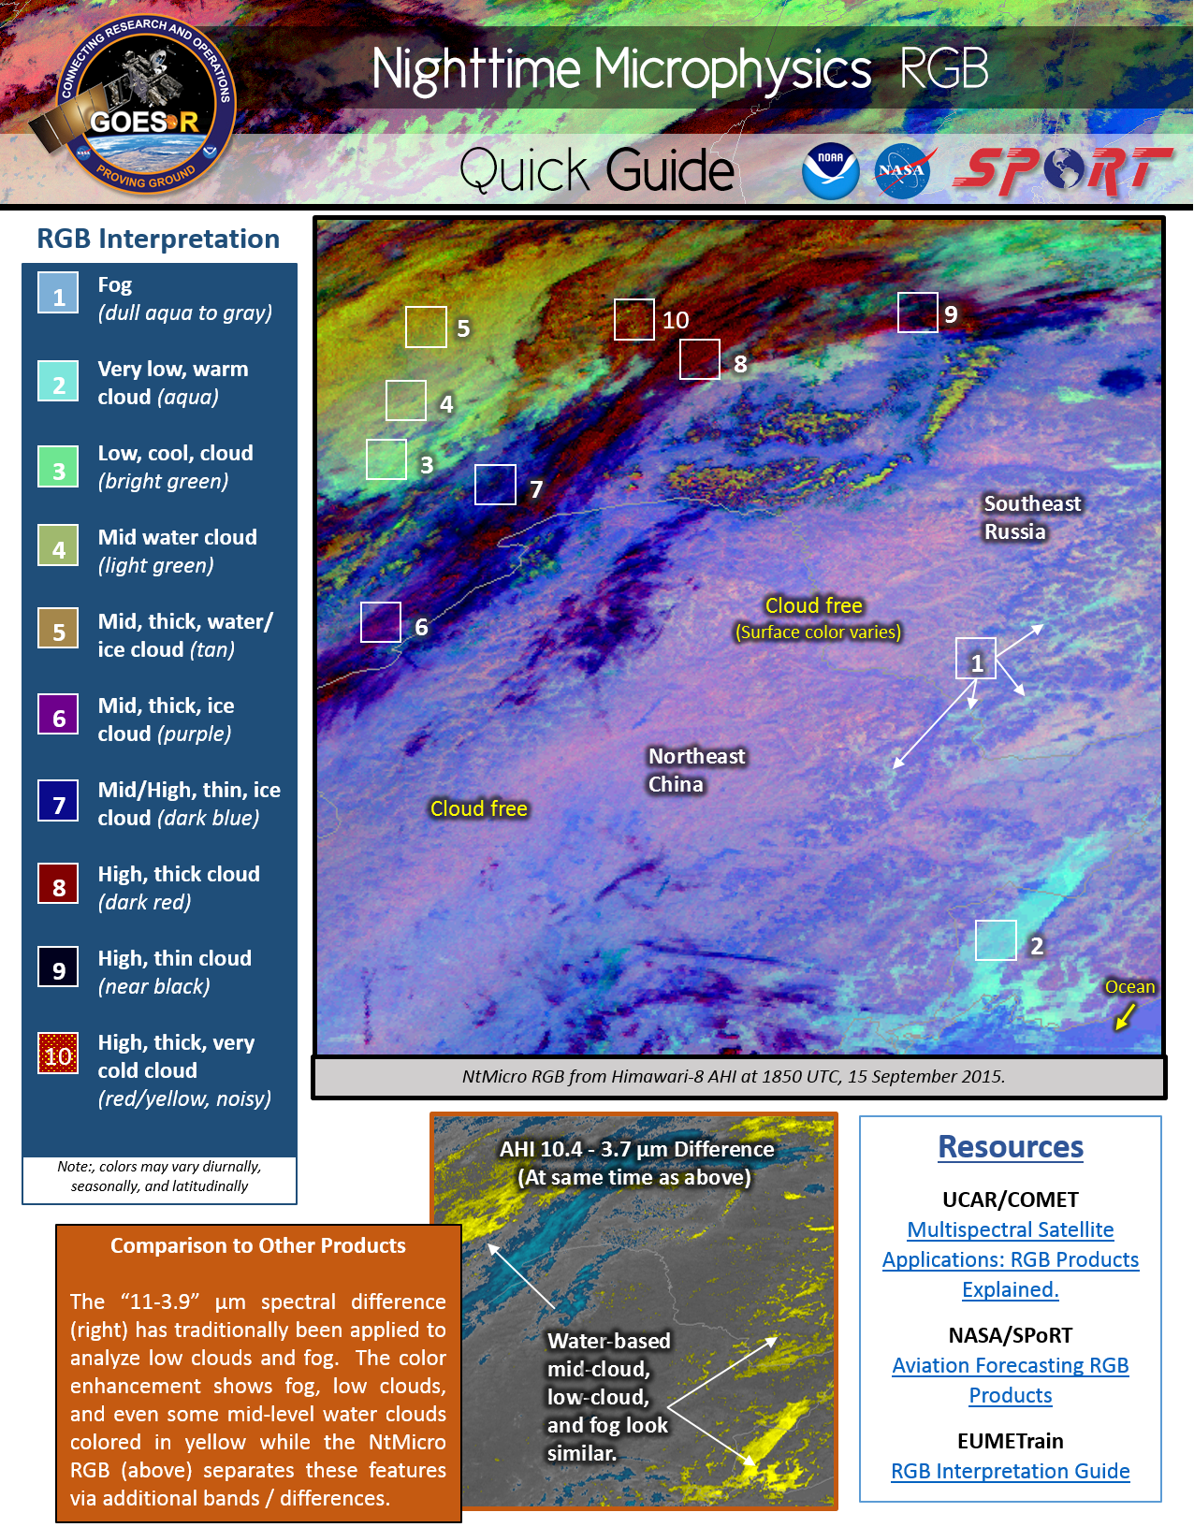
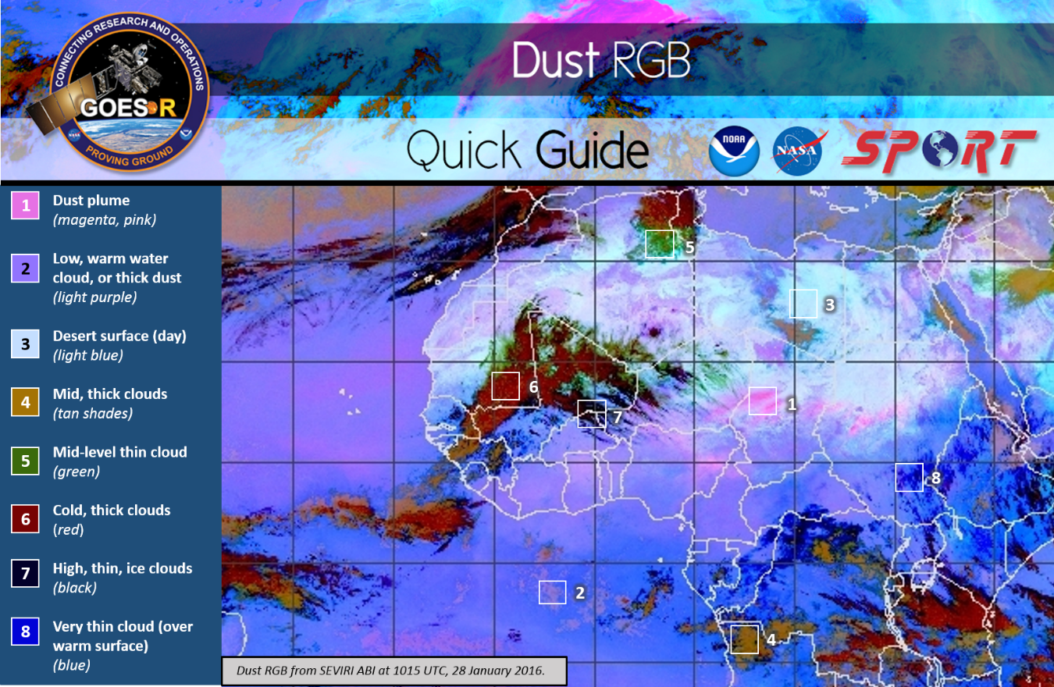
Training: quick guide
Introduced the 2-page “Quick Guide” (QG) style into operations and others in community duplicated this method
Highlight important points from modules/micro-lessons
Like “fast food” – fills need but can’t live purely on it
Intended to provide enough information as a reminder for operational applications. Not intended for history or detailed science discussion.
Evolved the concept to an interactive QG via browser and within AWIPS
Very useful for initial development of RGB imagery skills
Have many QGs for RGBs with AHI examples/images
See QGs in operations areas when on site visits;
Users requesting more QGs

Slide 17
Application Library: Concept
With the large number of new products added to the forecaster “tool box” from GOES-R and JPSS, it there is a need for user-based, sharing of applications that can easily and quickly be referenced.
“1-minute”, picture and paragraph
~3 minute videos (e.g. Youtube “how-to” items)
< 8 minute micro-lessons
Forecaster-based examples from operations vs. research cases
Linked to the AWIPS2 Integrated Training Tool using VLab capabilities

Slide 18
Applications Library: “1-minute” Format
Very quick examples/resources
Place in AWIPS Integrated Training for reference
“By users and for users”: Submitted by users and formed in the template by SPoRT
Vetted by product SME & operations individual before living in the library.
Serves as a source of “regional” training examples that support the other types of items in the library (like the short video/anim., or micro-lessons).

Slide 19
Applications Library - Short video
Analogous to finding “how to” instruction on YouTube or similar sites
Short examples of solid applications. 3-minute, continuous “video/module” with audio.
Incorporates multiple images and/or loops.
Application can be applied to multiple user groups or regions.
Many WFOs already capable of creating short “videos” for public and emergency management personnel
Screen capture example of initial development for “how-to” video regarding Air Mass RGB use with water vapor channel, and model vorticity and model upper level winds. Using H8/AHI data. Data displayed in AWIPS/CAVE.

Slide 20
Applications Library - micro-lesson
Guidelines
Develop script
Establish goal and learning objectives
Approx. minutes for sections (total 8 or less)
Intro – 1 min
Setup – 2 min
Product analysis – 2 min
Pmpact – 2 min
Conclusions – 1 min
Include pre-requisite knowledge in intro
Internal review of learning objectives, techniques, and type of content, as appropriate.
Also, science review. Need product developers/experts input and approval.
Less than 8-minute in length. More detail than other types, but still short.
Likely include an example as a result of user interaction via assessment/trial.
Still have assumptions made about user base knowledge, but may provide some reminders of the basic science and reference more robust resources.
Incorporate several other datasets/types to show use in operations as best as possible.

Slide 21
RGB micro-lesson Example (8 minutes)
Minutes for sections (total 8:20)
Intro – 1:22 min
Setup – 1:56 min
Product analysis & impact – 3:50 min
Conclusions – 1:14 min
Approx. minutes for sections (total 8 or less)
Intro – 1 min
Setup – 2 min
Product analysis – 2 min
Impact – 2 min
Conclusions – 1 min

Slide 22
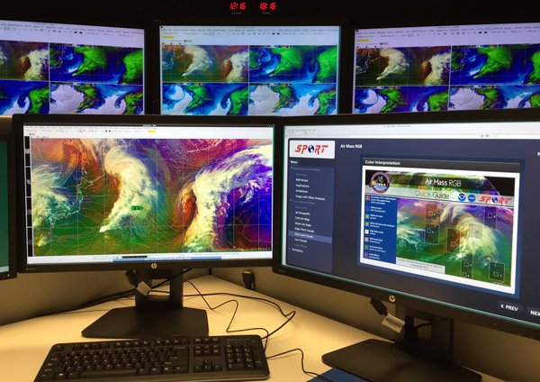
AWIPS/CAVE Integrated Training Tool
Successfully demonstrated at NWS Operations Proving Ground
Gives forecasters the ability to view training/references within operational workflow
Quick Guides
Short Modules
Applications Library Videos
Will be Baseline in AWIPS 2 version 16.4.1 later this year
Developing best practices and recommendations for the community to be incorporated in NWS VLab
Interest from NWS OCLO
Integrated Training Tool tested at Operations Proving Ground
”On a scale of 1-10....a 100. Integrated training ensures that training does not fall on the floor once foundational training is completed. It’s a way for forecasters to continually be able to reference the building blocks and apply those building blocks to applications and the forecast process…continue to build on the knowledge they've gained!” – Forecaster NWS OPG Demonstration

Slide 23
Summary
User Engagement
Training
Advocates, site visits, regular coordination calls
Collaborative product evaluations
User feedback to developers
Support to other NOAA Testbeds
Short, application-focused material
Modules, micro-lessons, Quick Guides
Builds on user foundational training from others in community
Applications Library
Examples from users in operations and from product evaluations
Very short formats for use/reference within operations
By users, for users (peer sharing)
Items linked within AWIPS/CAVE

Slide 24
Future Transition/Training
Assessment of NASA & NOAA capabilities and new missions to quantify value in operations
NASA/LIS, GOES-R, JPSS-1, ICESat-2, GPM/IMERG, etc.
Development of supporting training
Applications Library
Stock shelves with user-based cases
Total Lightning, RGB Imagery, NASA/LIS, etc.
Transition items to AWIPS/ITT via NWS VLab
Continued development of AWIPS/ITT functionality and best practices
Total Lightning (TL)
Providing materials to NWS foundational training and planning for ‘applications training’ phase
Development of materials for simulated cases, involving more than just severe wx
International collaborations with EUMETSAT and/or WMO on MTG-LI given our TL experiences
Integrated Training Tool to use Applications Library items

